Slide 1
The OTC Derivatives Market
Chapter 6

Slide 2
Financial Markets
Exchange traded
  Traditionally exchanges have used the open-outcry system, but electronic trading has now become the norm
  Contracts are standard; there is virtually no credit risk
Over-the-counter (OTC)
  A network of dealers at financial institutions, corporations, and fund managers who trade directly with each other
  Contracts can be non-standard; there is some credit risk

Slide 3
The Exchange-traded Market
The over-the-counter market is an alternative to the exchange-traded market
Exchanges define the products that can be traded
They involve market makers who quote bid and ask prices
Members of the exchange trade for themselves or for their clients
An exchange clearing house guarantees transactions and requires initial and variation margin

Slide 4
Variation Margin
  Margin reflecting change in value of a position
  Example: Party A and B trade. If value of outstanding positions to A increase by $X during day, then B has to provide A with $X of acceptable collateral

Slide 5
Initial Margin
Even if variation margin has been posted, A may still lose money if B defaults because:
  B is not up to date with margin payments at time of default
  A may be subject to bid-offer spreads when it replaces transactions
Initial margin can be used to provide additional protection

Slide 6
Haircuts
Often margin is cash and interest is normally paid on cash balances
Sometimes securities are provided instead of cash.
There then may be a “haircut” where the market value of the securities is reduced by a certain percentage to determine their value for collateral purposes.

Slide 7
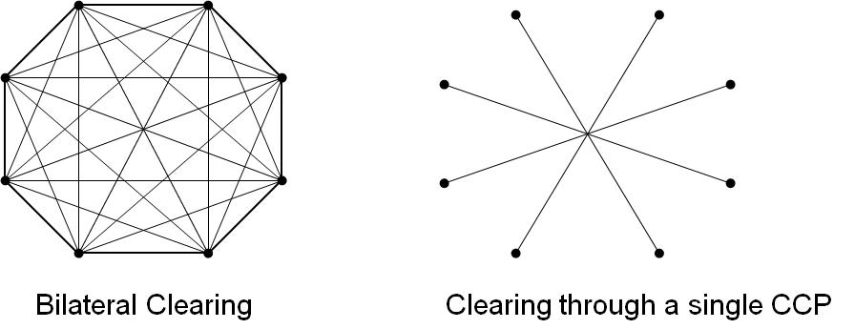
Clearing Arrangements for OTC Derivatives (Figure 6.1, page 132)
Bilateral clearing: usually governed by an ISDA Master agreement
Central clearing: a central counterparty (CCP) stands between the two sides
CCP
CCCCCP

Slide 8
Central Clearing (Figure 6.2, page 133)
The OTC Trade
5%
Company A
Company B
Floating Rate
Role of CCP
5%
5%
Company A
CCP
Company B
Floating Rate
Floating Rate

Slide 9
Central Clearing continued
Role of CCP is very similar to that of an exchange clearing house.
It stands between two sides
It requires initial margin and variation margin from its members reflecting all their transactions with CCP
Initial margin roughly covers 5 day price moves with 99% confidence
The members may be clearing trades for other trading entities

Slide 10
Large CCPs (page 133)
SwapClear (part of LCH Clearnet in London)
Clearport (part of CME Group in Chicago)
ICE Clear Credit (part of Intercontinental Exchange)

Slide 11
Waterfall for Funding Losses when Positions Have to be Closed Out (CCP or Exchange Clearing House)
Initial margin of defaulting member
Default fund contributions of defaulting member
Default fund contributions of other members
Equity of CCP/Exchange Clearing House

Slide 12
Bilateral Clearing
OTC agreement directly between two sides
Usually governed by an ISDA master agreement
This contains a credit support annex (CSA) identifying collateral arrangements
Early termination provisions in the event of default not subject to usual bankruptcy rules
  Non-defaulting party can keep collateral posted up to amount owed.
  Claim by non-defaulting party reflects mid market values adjusted for half the bid-offer spread

Slide 13
Netting (page 135)
Feature of both ISDA master agreements and CCPs
All transactions are considered to be a single transaction…
  in the event of default
  for collateral calculations
Netting reduces initial margin requirements

Slide 14
Post-Crisis Regulatory Changes 1
All standardized derivatives (i.e., plain vanilla interest rate swaps and index credit default swaps) between financial institutions must be cleared through CCPs
Standardized derivatives between financial institutions must be traded on electronic platforms
All OTC trades must be reported to a central trade repository

Slide 15
Post-Crisis Regulatory Changes 2
Initial margin and variation margin must be posted for nonstandard trades between financial institutions (These are referred to as “uncleared” trades because they are cleared bilaterally, rather than through a CCP)
Variation margin is transferred directly between the two sides
Initial margin is posted with a third party

Slide 16
Post-Crisis Regulatory Changes 2 continued
Initial margin for uncleared trades between financial institutions must cover 10-day price movements in stressed market conditions with 99% confidence
Margin rules for uncleared trades were implemented starting in 2016

Slide 17
Calculation of Initial Margin for Uncleared Trades
Basel Committee proposes a grid approach where initial margin is a percent of notional principal (no netting)
ISDA proposes Standard Initial Margin Model (SIMM) which uses a version of the model building approach for handling delta and gamma risk (see Appendix M)

Slide 18
Collateral Increases
Much more collateral will be needed to support derivatives trading
This collateral will usually have to be cash or government securities
This is liable to create liquidity pressures

Slide 19
CCPs and Netting
CCPs should increase netting, because transactions with two different counterparties can be netted if both are cleared through the same CCP
But it will no longer be possible to net standard with nonstandard transactions
It is therefore conceivable that benefits of netting could decrease….

Slide 20
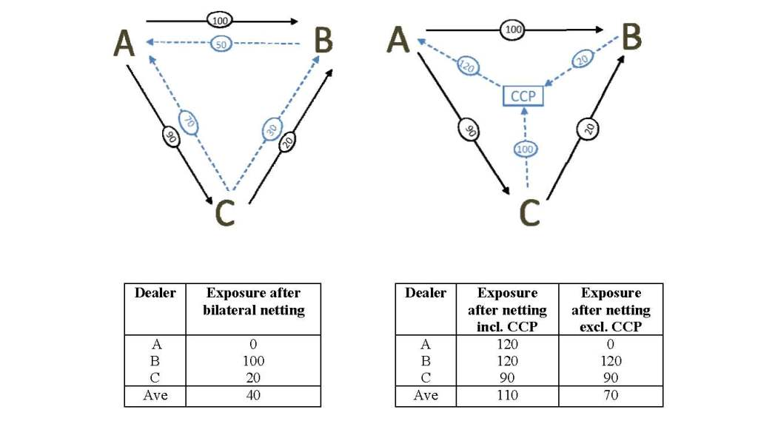
Simple Example: 3 market participants; 2 product types

Slide 21
Rehypothecation (page 140-141)
This involves using the collateral posted with you by one counterparty to satisfy the collateral demands of another party.
It will be restricted under the new rules

Slide 22
A Convergence…
OTC and exchange-traded derivatives markets are becoming more similar to each other as far as
  the way trading is done
  the way transactions are cleared
  The collateral (margin) that has to be posted

Slide 23
CCPs and Too-Big-To Fail
It can be argued that CCPs are the new TBTF financial institutions
However, CCPs are much easier to regulate than banks and so moving risks to CCPs may make the financial system easier to regulate and therefore safer

